Slide 1

DIGITAL CIRCUIT (ECL256)

Slide 2
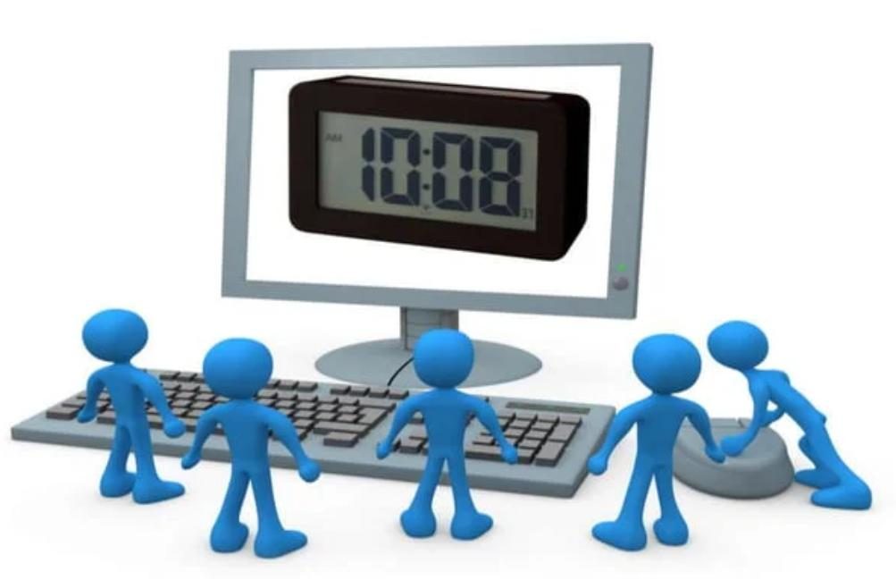
DIGITAL CLOCK

Slide 3

PRESENTED TO: Mr. VIVEK KUMAR
PRESENTERS:
RAJIV GUPTA
SAURABH KUMAR JHA
MANISH KUMAR
SHIVANI KARNWAL
DEEPANSHI RANA

Slide 4
CONTENT:
About Digital Clock
History of Digital Clock
Introduction
Requirement
Code

Slide 5
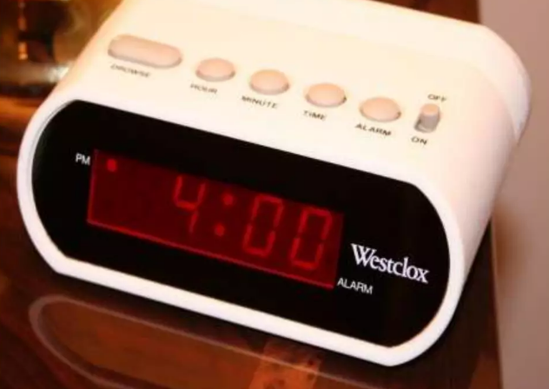
About Digital Clock
A digital clock is a type of clock that displays time
digitally On seven segment display.

Slide 6
HISTORY OF DIGITAL CLOCK
The first digital pocket watch was the invention of Austrian engineer Josef Pall Weber who created his “jump-hour” mechanism in 1883.
The earliest patent for a digital alarm clock was registered by D.E. Protzmann and others on October 23, 1956 , in the United States.
The Hamilton Watch Company introduced the first digital wristwatch that included an LED display in 1970.

Slide 7
INTRODUCTION
We know that 60 seconds equal to 1 minute and 60 minutes equal to 1 hour. Hence the minute section is derived by second section and hour section by the minute section. Each of the minute and second section has been designed to give a count from 00 to 59 after which it resets to 00, and the hour section to give a count from 00 to 11 hours after which it resets to 00. For each cycle of 00 to 59 in second section ,the minute section increases its count by 1. Similarly for each cycle of 00 to 59 in minute section, the hour section increases it’s count by 1. In this way when the clock reaches 11hrs. 59mins. 59secs each of the section resets to 00 giving us a display 00.00.00 popularly known as the 0th hour.

Slide 8


REQUIREMENTS:
SOFTWARE

Slide 9
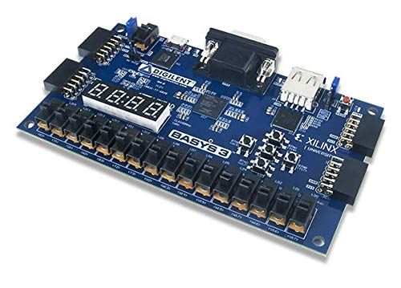
HARDWARE
BASYS 3

Slide 10
CODES ~

Slide 11
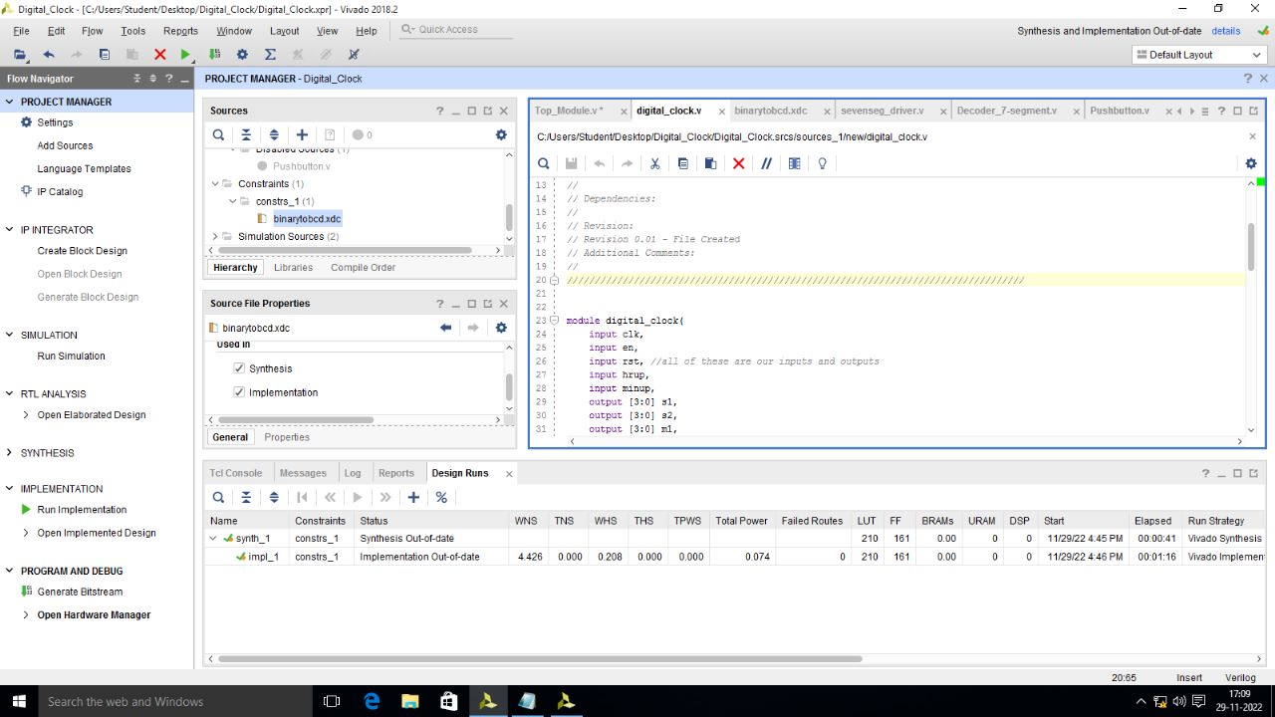
DIGITAL CLOCK

Slide 12

TOP MODULE

Slide 13
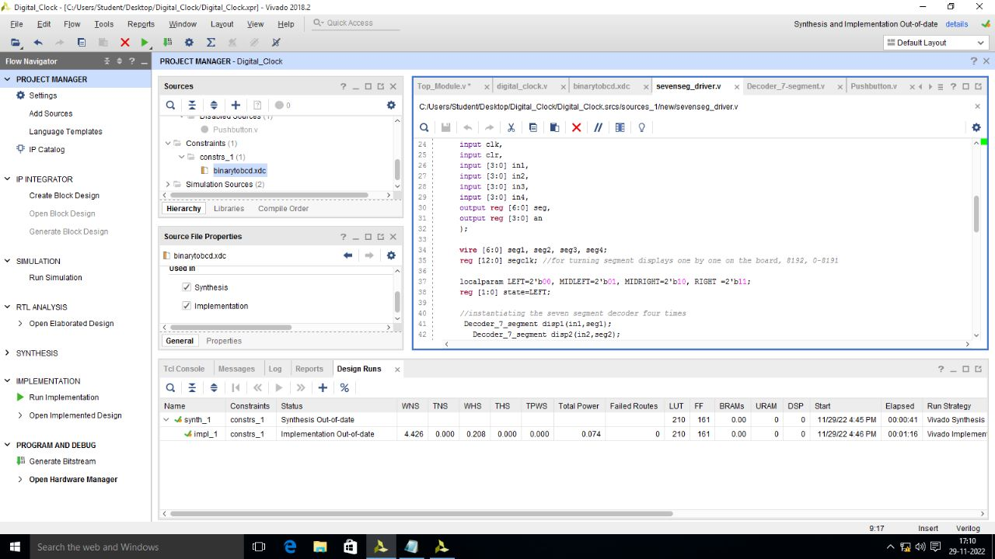

Slide 14
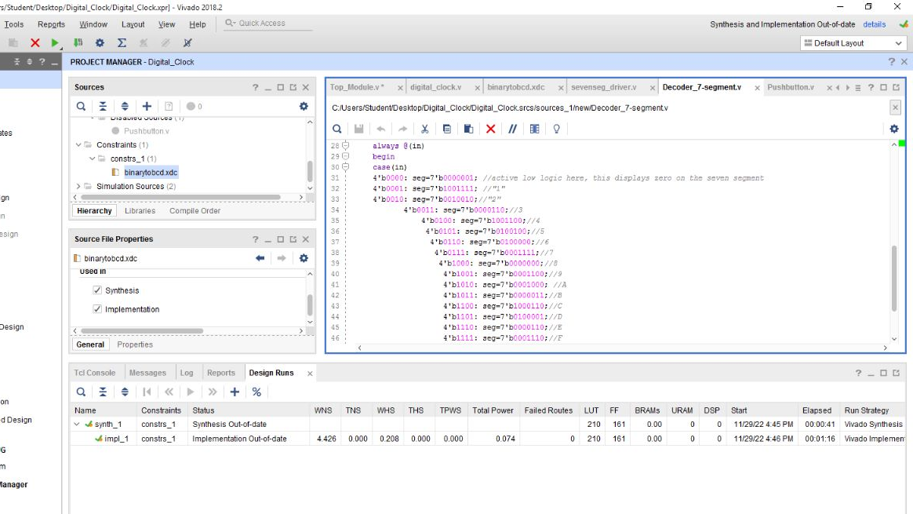
Decoder 7 segment

Slide 15
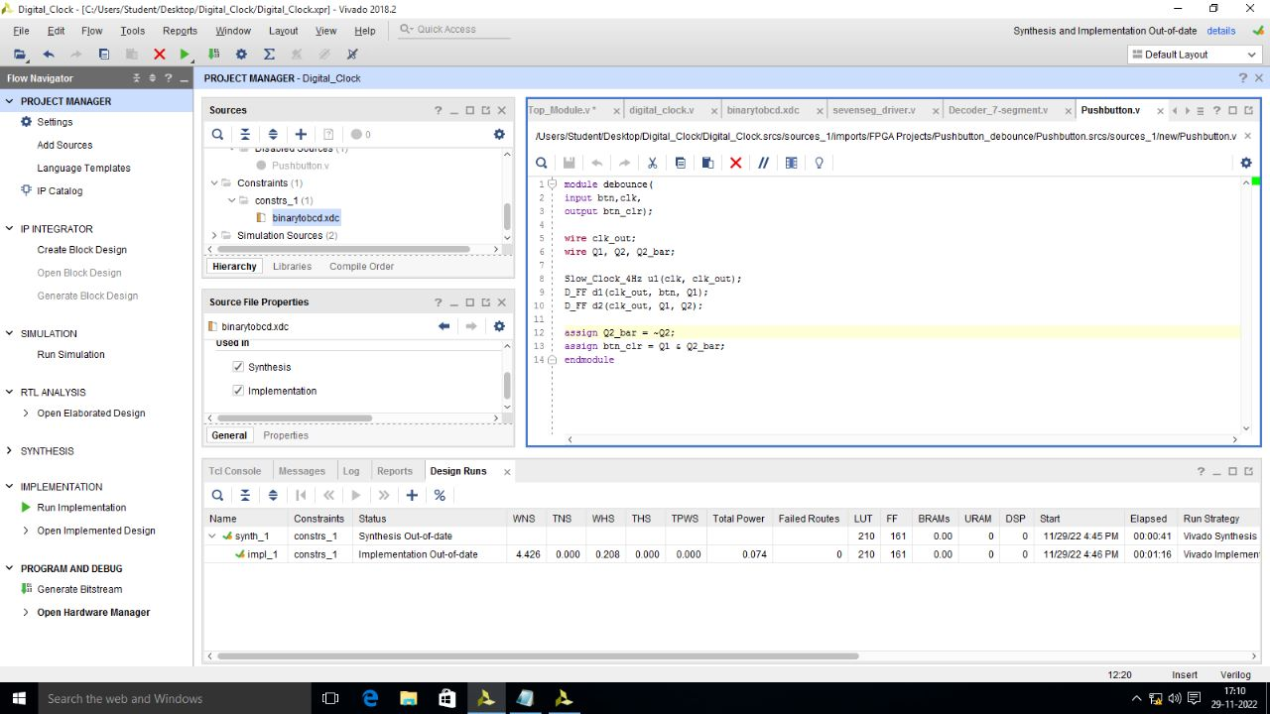
Pushbutton

Slide 16
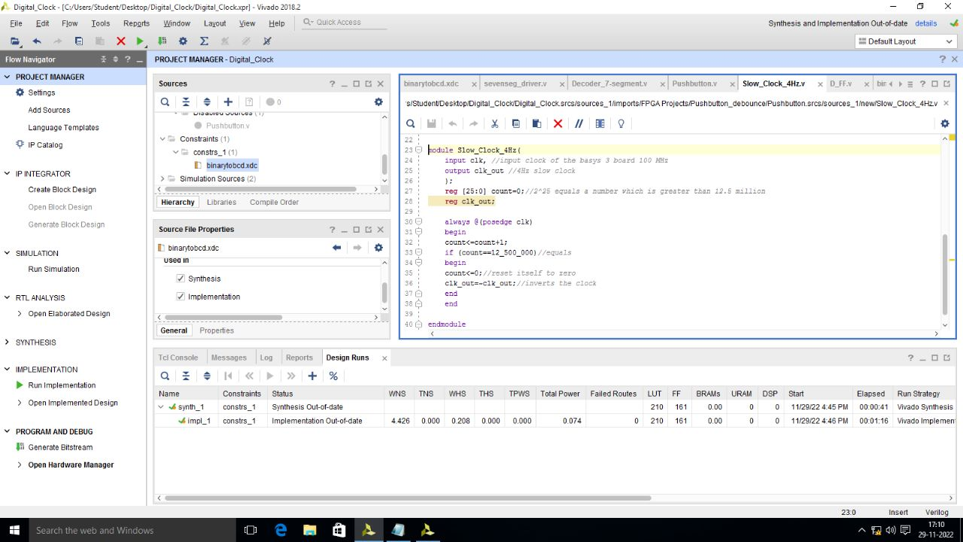
Slow clock

Slide 17
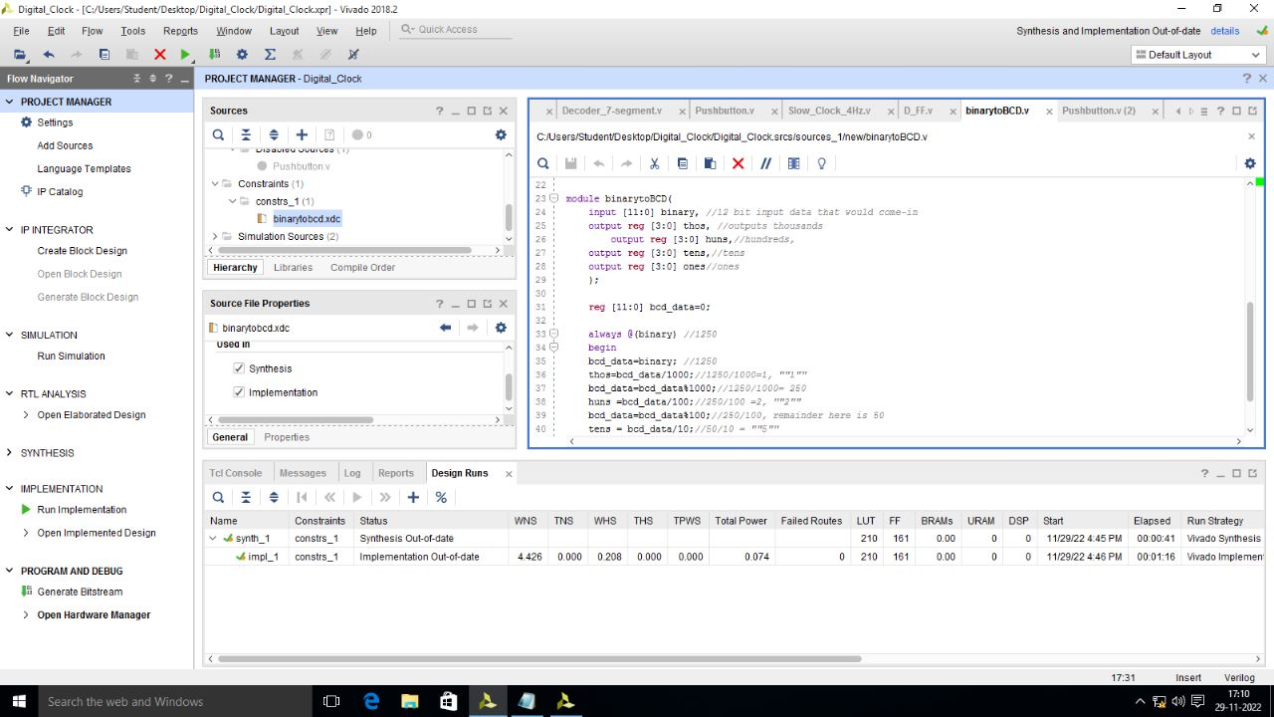
BCD to binary.

Slide 18

Implement on FPGA

Slide 19
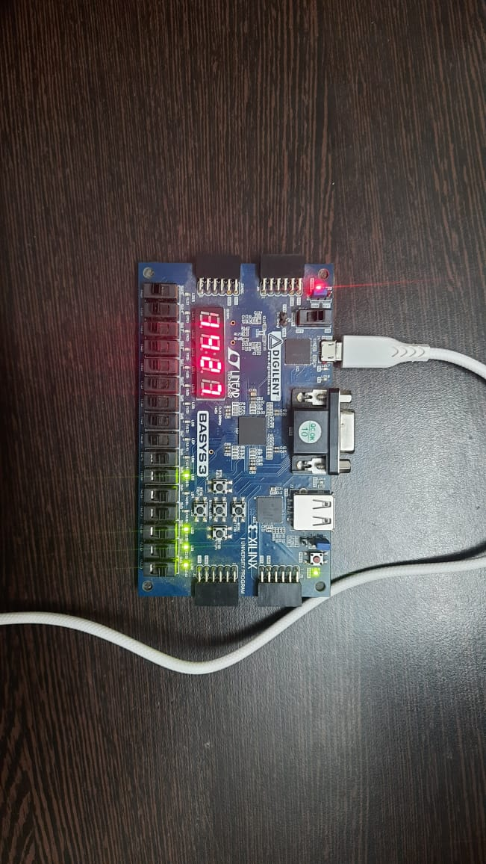
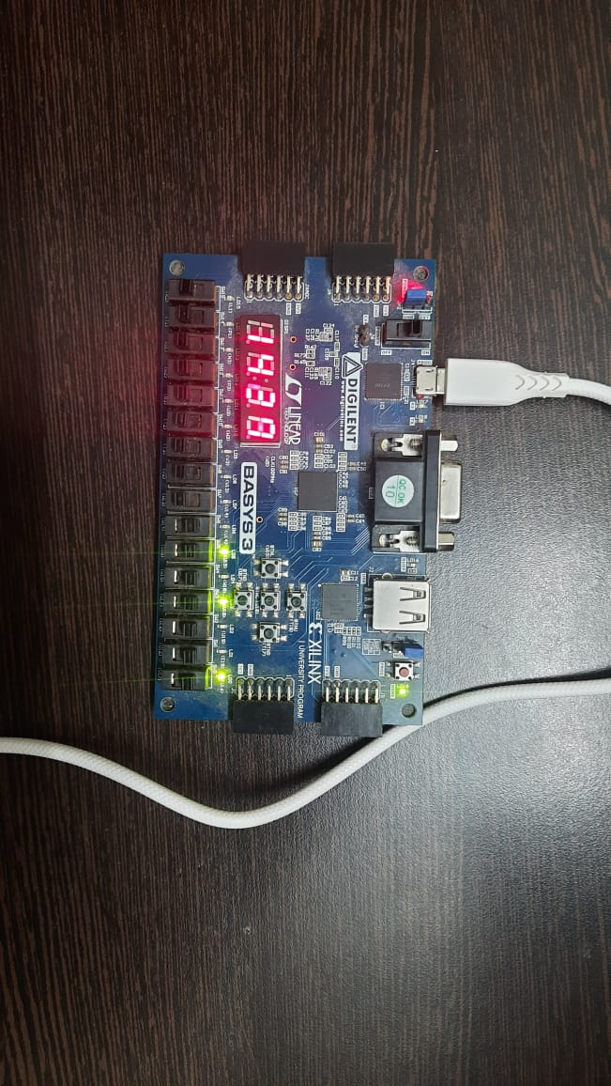
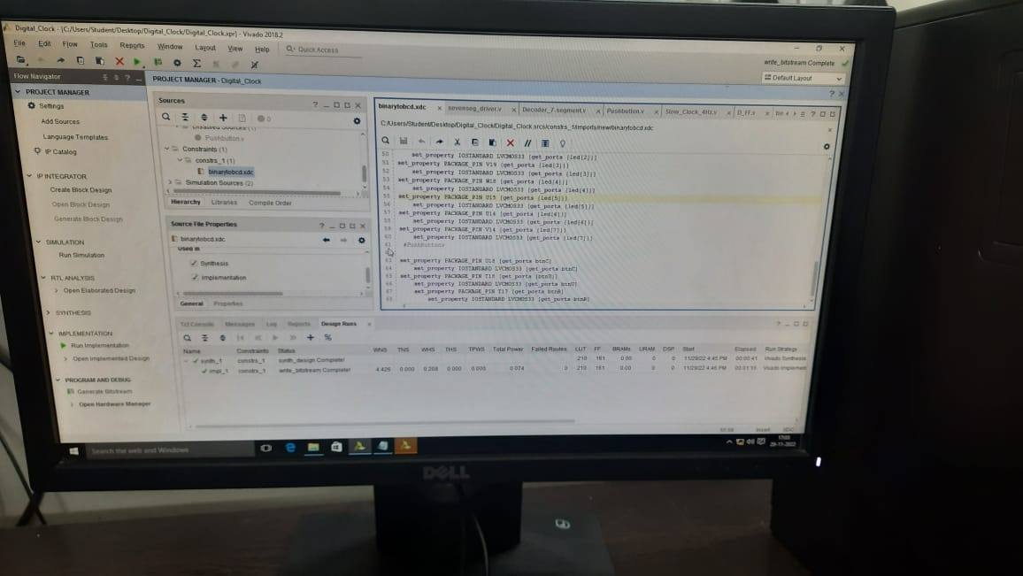
FPGA board running via Verilog code

Slide 20

Thank you

